Slide 1
Network IPC: Sockets
시스템 프로그래밍
Fall 2013
Div. of Computer Science & Engineering

Slide 2
Introduction
Socket network IPC interface to support process communication on the same machine or on different machines
Classical IPCs : pipes, FIFOs, message queues, semaphores, and shared memory on the same computer
The POSIX.1 socket API based on the 4.4BSD socket interface
Originally introduced in 4.2BSD in the early 1980s.

Slide 3
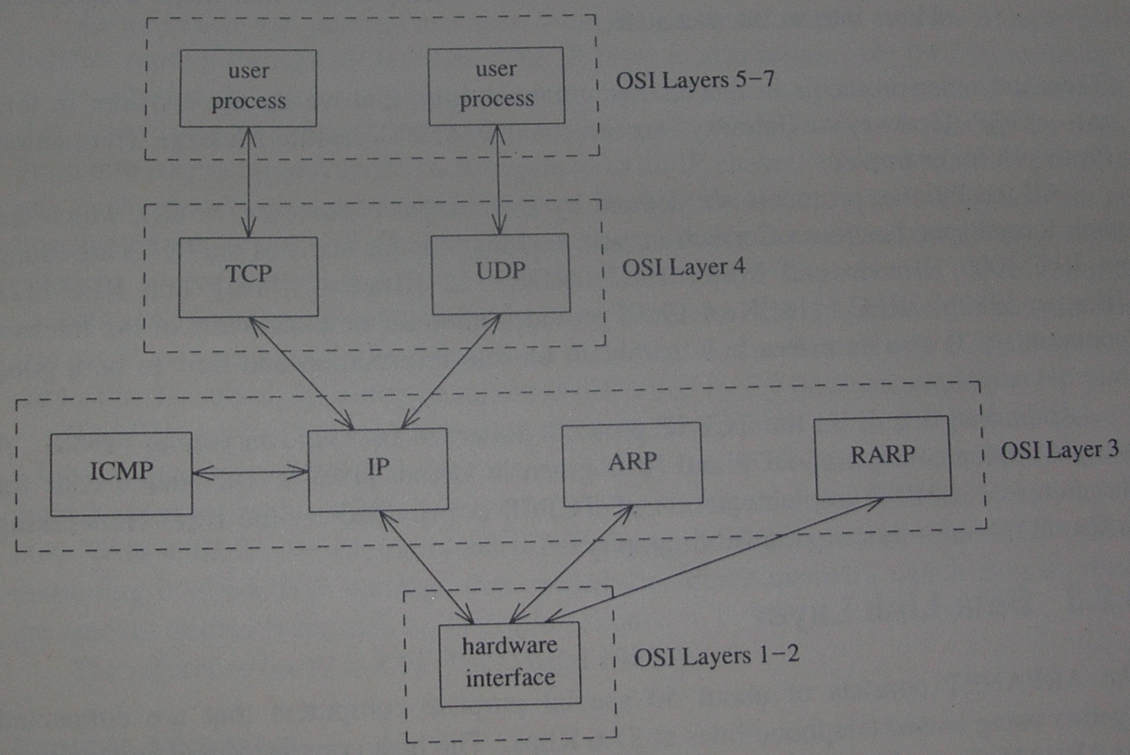
The Internet Protocol Suite

Slide 4
Connection-Oriented vs. Connectionless
Connectionless protocol (Datagram interface)
A datagram is a self-contained message.
Sending a datagram is analogous to mailing someone a letter.
No logical connection between peers
Subject to out-of-order delivery and loss
UDP (User Datagram Protocol)
Connection-oriented protocol (Stream interface)
Like making a phone call.
A point-to-point virtual connection between both ends of the call
TCP (Transmission Control Protocol)

Slide 5
Socket Descriptors
A socket is an abstraction of a communication endpoint.
Socket descriptors to access sockets
Implemented as file descriptors
#include <sys/socket.h>
int socket(int domain, int type, int protocol);
Domain: AF_INET, AF_INET6, AF_UNIX, AF_UNSPEC
Types: SOCK_DGRAM, SOCK_RAW, SOCK_SEQPACKET, SOCK_STREAM
Protocol: zero value to indicate the default protocol for the given domain and socket type
TCP for AF_INET and SOCK_STREAM
UDP for AF_INET and SOCK_DGRAM
Notes:
A SOCK_SEQPACKET socket is just like a SOCK_STREAM socket except that we get a message-based service instead of a byte-stream service.
A SOCK_RAW socket provides a datagram interface directly to the underlying network layer (which means IP in the Internet domain.) Applications are responsible for building their own protocol headers when using this interface, because the transport protocols (TCP and UDP, for example) are bypassed.

Slide 6
Socket Types
Type | Description
SOCK_DGRAM SOCK_RAW SOCK_SEQPACKET SOCK_STREAM | fixed-length, connectionless, unreliable messages datagram interface to IP (optional in POSIX.1) fixed-length, sequenced, reliable, connection-oriented messages sequenced, reliable, bidirectional, connection-oriented byte streams
Notes:
A SOCK_SEQPACKET socket is just like a SOCK_STREAM socket except that we get a message-based service instead of a byte-stream service.
A SOCK_RAW socket provides a datagram interface directly to the underlying network layer (which means IP in the Internet domain.) Applications are responsible for building their own protocol headers when using this interface, because the transport protocols (TCP and UDP, for example) are bypassed.

Slide 7
Byte Ordering
Big-endian
Little-endian
n n+1 n+2 n+3
n+3 n+2 n+1 n
MSB LSB
MSB LSB
The TCP/IP protocol suite uses big-endian byte order.
Network byte order vs. processor byte order
#include <arpa/inet.h>
uint32_t htonl(uint32_t hostint32);
uint16_t htons(uint16_t hostint16);
uint32_t ntohl(uint32_t netint32);
uint16_t ntohs(uint16_t netint16);
Notes:
Addressing : To identify the process that we want to communicate with
The machine’s network address and service on the machine

Slide 8
Address Formats
An address identifies a socket endpoint. Its format is specific to the particular domain, being cast to a generic sockaddr address structure to be passed to socket functions.
struct sockaddr {
sa_family_t sa_family; /* address family */
char sa_data[]; /* variable-length address */
…
}
Internet address defined in <netinet/in.h>
struct in_addr {
in_addr_t s_addr; /* IPv4 address */
};
struct sockaddr_in {
sa_family_t sin_family; /* address family */
in_port_t sin_port; /* port number */
struct in_addr sin_addr; /* IPv4 address */
};
Notes:
In_port_t defined to be a uint16_t
In_addr_t defined to be a uint32_t

Slide 9
Address Formats
#include <arpa/inet.h>
const char *inet_ntop(int domain, const void *addr, char *str, socklen_t size);
int inet_pton(int domain, const char *str, void *addr);
Conversion between the binary address format and the dotted-decimal notation
Only AF_INET and AF_INET6 domains supported
Notes:
In_port_t defined to be a uint16_t
In_addr_t defined to be a uint32_t

Slide 10
Address Lookup
#include <netdb.h>
struct hostent *gethostent(void);
void sethostent(int stayopen);
void endhostent(void);
struct hostent {
char *h_name; /* name of host */
char **h_alias; /* pointer to alternate host name array */
int h_addrtype; /* address type */
int h_length; /* length in bytes of address */
char **h_addr_list; /* pointer to array of network addresses */
}
struct netent *getnetent(void);
struct protoent *getprotoent(void);
strcut servent *getservent(void);
Notes:
In_port_t defined to be a uint16_t
In_addr_t defined to be a uint32_t

Slide 11
Address Lookup
Mapping from a host name and a service name to an address
#include <sys/sock.h>
#include <netdb.h>
int getaddrinfo(const char *host, const char *service, const struct addrinfo *hint, struct addrinfo **res);
void freeaddrinfo(struct addrinfo *ai);
struct addrinfo {
int ai_flags;
int ai_family;
int ai_socktype;
int ai_protocol;
socklen_t ai_addrlen;
struct sockaddr *ai_addr;
char *ai_canonname;
struct addrinfo *ai_next;
.
.
};
Notes:
We can supply an optional hint to select addresses that meet certain criteria. The hint is a template used for filtering addresses and uses only the ai_familiy, ai_flags, ai_protocol, and ai_socktype fields.

Slide 12
Address Lookup
Mapping from an address to a host name and a service name
#include <sys/sock.h>
#include <netdb.h>
int getnameinfo(const struct sockaddr *addr, socklen_t alen, char *host, socklen_t hostlen, char *service, socklen_t servlen, unsinged int flags);
Figure 16.8
$ ./a.out harry nfs
flags canon family inet type stream protocol TCP
host harry address 192.168.1.105 port 2049
flags canon family inet type stream protocol UDP
host harry address 192.168.1.105 port 2049

Slide 13
Address Lookup
…
void print_family(struct addrinfo *aip)
{
printf(" family ");
switch (aip->ai_family) {
case AF_INET: printf("inet");
break;
case AF_INET6: printf("inet6");
break;
case AF_UNIX: printf("unix");
break;
case AF_UNSPEC: printf("unspecified");
break;
default: printf("unknown");
}
}
void print_type(struct addrinfo *aip)
{
printf(" type ");
switch (aip->ai_socktype) {
case SOCK_STREAM: printf("stream");
break;
case SOCK_DGRAM: printf("datagram");
break;
case SOCK_SEQPACKET: printf("seqpacket");
break;
case SOCK_RAW: printf("raw");
break;
default: printf("unknown (%d)", aip->ai_socktype);
}
}
void print_protocol(struct addrinfo *aip)
{
printf(" protocol ");
switch (aip->ai_protocol) {
case 0: printf("default");
break;
case IPPROTO_TCP: printf("TCP");
break;
case IPPROTO_UDP: printf("UDP");
break;
case IPPROTO_RAW: printf("raw");
break;
default: printf("unknown (%d)", aip->ai_protocol);
}
}
void print_flags(struct addrinfo *aip)
{
printf("flags");
if (aip->ai_flags == 0) { printf(" 0");
} else {
if (aip->ai_flags & AI_PASSIVE) printf(" passive");
if (aip->ai_flags & AI_CANONNAME) printf(" canon");
if (aip->ai_flags & AI_NUMERICHOST) printf(" numhost");
#if defined(AI_NUMERICSERV)
if (aip->ai_flags & AI_NUMERICSERV) printf(" numserv");
#endif
#if defined(AI_V4MAPPED)
if (aip->ai_flags & AI_V4MAPPED) printf(" v4mapped");
#endif
#if defined(AI_ALL)
if (aip->ai_flags & AI_ALL) printf(" all");
#endif
}
}
Figure 16.8
Notes:
write to a file opened with O_APPEND flag: atomic since it causes the kernel to position the file to its current EOF before each write.

Slide 14
Address Lookup
int main(int argc, char *argv[])
{
struct addrinfo *ailist, *aip;
struct addrinfo hint;
struct sockaddr_in *sinp;
const char *addr;
int err;
char abuf[INET_ADDRSTRLEN];
if (argc != 3)
err_quit("usage: %s nodename service",
argv[0]);
hint.ai_flags = AI_CANONNAME;
hint.ai_family = 0;
hint.ai_socktype = 0;
hint.ai_protocol = 0;
hint.ai_addrlen = 0;
hint.ai_canonname = NULL;
hint.ai_addr = NULL;
hint.ai_next = NULL;
if ((err = getaddrinfo(argv[1], argv[2], &hint, &ailist)) != 0)
err_quit("getaddrinfo error: %s", gai_strerror(err));
for (aip = ailist; aip != NULL; aip = aip->ai_next) {
print_flags(aip);
print_family(aip);
print_type(aip);
print_protocol(aip);
printf("\n\thost %s",
aip->ai_canonname?aip->ai_canonname:"-");
if (aip->ai_family == AF_INET) {
sinp = (struct sockaddr_in *)aip->ai_addr;
addr = inet_ntop(AF_INET, &sinp->sin_addr, abuf,
INET_ADDRSTRLEN);
printf(" address %s", addr?addr:"unknown");
printf(" port %d", ntohs(sinp->sin_port));
}
printf("\n");
}
exit(0);
}
Figure 16.8
Notes:
write to a file opened with O_APPEND flag: atomic since it causes the kernel to position the file to its current EOF before each write.

Slide 15
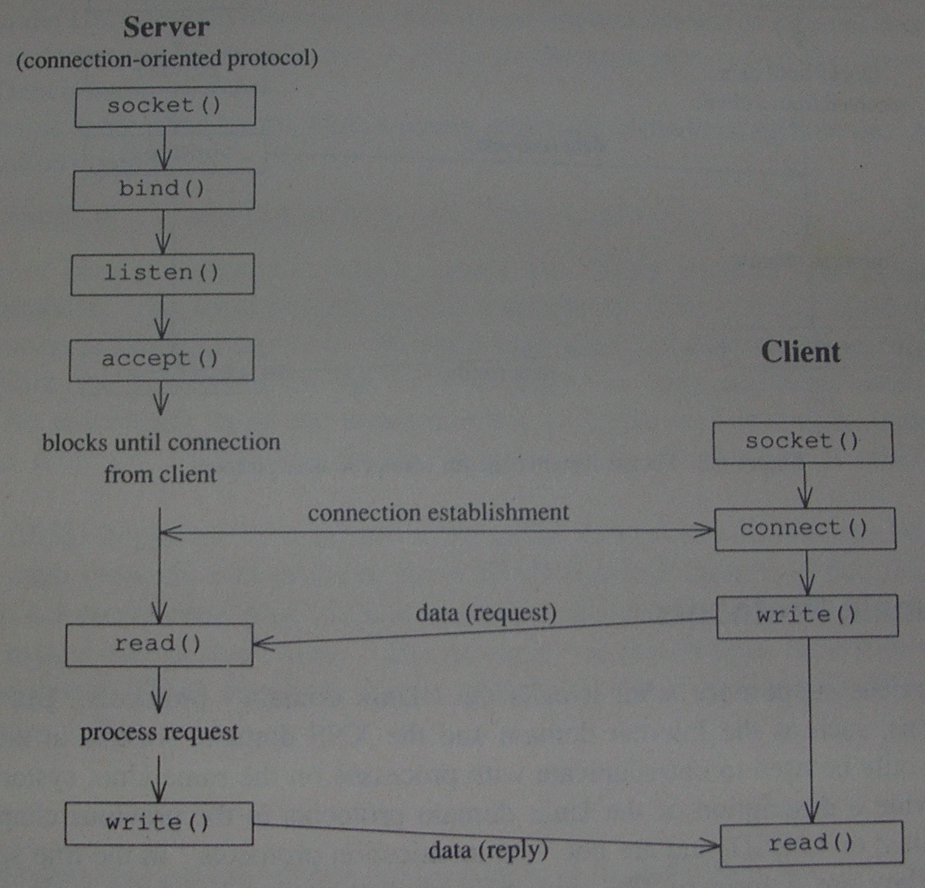
Socket System Calls for Connection-Oriented Protocol

Slide 16
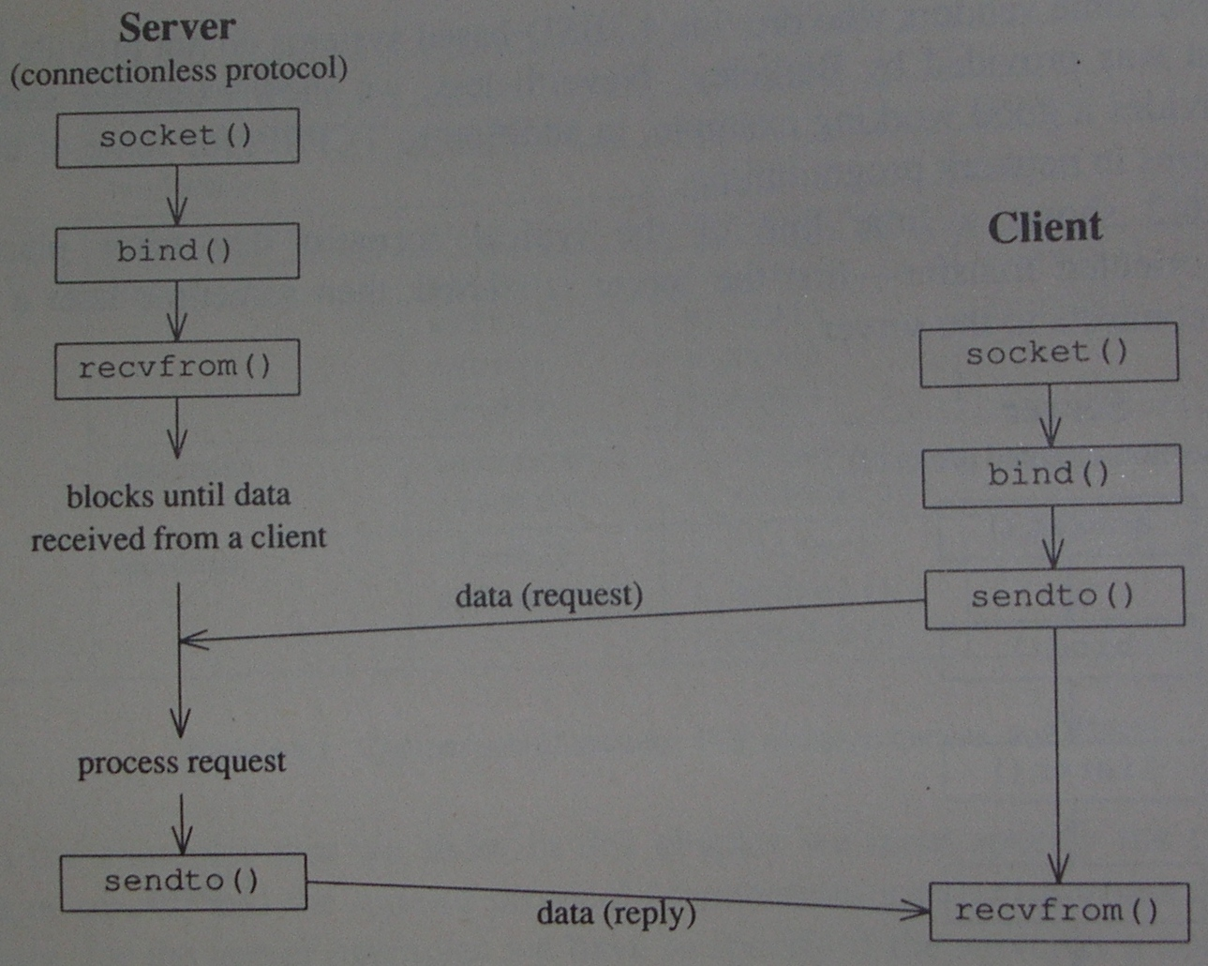
Socket System Calls for Connectionless Protocol

Slide 17
Associating Addresses with Sockets
#include <sys/socket.h>
int bind(int sockfd, const struct sockaddr *addr, socklen_t len);
int getsockname(int sockfd, struct sockaddr *addr, socklen_t *alenp);
int getpeername(int sockfd, struct sockaddr *addr, socklen_t *alenp);
To associate an address with a socket, to discover the address bound to a socket, and to find out the peer’s address
For a client’s socket, we can let the system choose a default address for us, whereas a well-known address should be associated with the server’s socket.
The system will choose an address and bind it to our socket, if we call connect or listen without first binding an address to the socket.

Slide 18
Connection Establishment
#include <sys/socket.h>
int connect(int sockfd, const struct sockaddr *addr, socklen_t len);
It creates a connection to the specified server, addr. If sockfd is not bound to an address, a default address will be bound to the caller.
Figure 16.9

Slide 19
Connection Establishment
#include "apue.h"
#include <sys/socket.h>
#define MAXSLEEP 128
int connect_retry(int sockfd, const struct sockaddr *addr, socklen_t alen)
{
int nsec;
/* Try to connect with exponential backoff. */
for (nsec = 1; nsec <= MAXSLEEP; nsec <<= 1) {
if (connect(sockfd, addr, alen) == 0) {
/* Connection accepted. */
return(0);
}
/* Delay before trying again. */
if (nsec <= MAXSLEEP/2)
sleep(nsec);
}
return(-1);
}
Figure 16.9
Notes:
write to a file opened with O_APPEND flag: atomic since it causes the kernel to position the file to its current EOF before each write.

Slide 20
Connection Establishment
#include <sys/socket.h>
int listen(int sockfd, int backlog);
The backlog argument provides a hint to the system of the number of outstanding connect requests that it should enqueue on behalf of the process.

Slide 21
Connection Establishment
#include <sys/socket.h>
int accept(int sockfd, struct sockaddr *addr, socklen_t *len);
The file descriptor returned is a socket descriptor that is connected to the client that called connect. This new socket descriptor has the same socket type and address family as sockfd.
The original socket passed to accept is not associated with the connection, but instead remains available to receive additional connect requests.
On return, accept will fill in the client’s address in addr.
Figure 16.10
Notes:
Once a server has called listen, it uses the accept function to retrieve a connect request and convert that into a connection.

Slide 22
Connection Establishment
#include "apue.h"
#include <errno.h>
#include <sys/socket.h>
int initserver(int type, const struct sockaddr *addr, socklen_t alen, int qlen)
{
int fd; int err = 0;
if ((fd = socket(addr->sa_family, type, 0)) < 0)
return(-1);
if (bind(fd, addr, alen) < 0) {
err = errno;
goto errout;
}
if (type == SOCK_STREAM || type == SOCK_SEQPACKET) {
if (listen(fd, qlen) < 0) {
err = errno;
goto errout;
}
}
return(fd);
errout:
close(fd); errno = err; return(-1);
}
Figure 16.10
Notes:
write to a file opened with O_APPEND flag: atomic since it causes the kernel to position the file to its current EOF before each write.

Slide 23
Data Transfer
read/write can be used to communicate with a socket.
#include <sys/socket.h>
ssize_t send(int sockfd, const void *buf, size_t nbytes, int flags);
#include <sys/socket.h>
ssize_t sendto(int sockfd, const void *buf, size_t nbytes, int flags, const struct sockaddr *destaddr, socklen_t destlen);
With a connection-oriented socket, the destination address is ignored, as the destination is implied by the connection. (With a connectionless socket, we can’t use send unless the destination address is first set by calling connect.)
Notes:
Flags = MSG_DONTROUTE, MSG_DONTWAIT(enable nonblocking operation = equivalent to using O_NONBLOCK), MSG_EOR, MSG_OOB

Slide 24
Data Transfer
#include <sys/socket.h>
ssize_t recv(int sockfd, void *buf, size_t nbytes, int flags);
#include <sys/socket.h>
ssize_t recvfrom(int sockfd, void *buf, size_t len, int flags, struct sockaddr *addr, socklen_t *addrlen);
Notes:
Because it allows us to retrieve the address of the sender, recvfrom is usually used with connectionless sockets. Otherwise, recvfrom behaves identically to recv.

Slide 25
Data Transfer
Connection-oriented ruptime
More work and time are needed to establish a connection, and each connection consumes more resources from the O.S.
Client (Figure 16.14)
Server (Figure 16.16)
Connectionless ruptime
With a connectionless socket, packets can arrive out of order, and can be lost.
Client (Figure 16.17)
Server (Figure 16.18)
Notes:
Connectionless ruptime client
- If the server isn’t running, the client will block indefinitely in the call to recvfrom. With the connection-oriented example, the connect call will fail if the server isn’t running. To avoid blocking indefinitely, we set an alarm clock before calling recvfrom.

Slide 26
Data Transfer
int main(int argc, char *argv[])
{
struct addrinfo *ailist, *aip;
struct addrinfo hint;
int sockfd, err;
if (argc != 2) err_quit("usage: ruptime hostname");\
hint.ai_flags = 0;
hint.ai_family = 0;
hint.ai_socktype = SOCK_STREAM;
hint.ai_protocol = 0;
hint.ai_addrlen = 0;
hint.ai_canonname = NULL;
hint.ai_addr = NULL;
hint.ai_next = NULL;
if ((err = getaddrinfo(argv[1], "ruptime", &hint, &ailist)) != 0)
err_quit("getaddrinfo error: %s", gai_strerror(err));
for (aip = ailist; aip != NULL; aip = aip->ai_next) {
if ((sockfd = socket(aip->ai_family, SOCK_STREAM, 0)) < 0)
err = errno;
if (connect_retry(sockfd, aip->ai_addr, aip->ai_addrlen) < 0) {
err = errno;
} else {
print_uptime(sockfd);
exit(0);
}
}
fprintf(stderr, "can't connect to %s: %s\n", argv[1], strerror(err));
exit(1);
}
#include "apue.h"
#include <netdb.h>
#include <errno.h>
#include <sys/socket.h>
#define MAXADDRLEN 256
#define BUFLEN 128
extern int connect_retry(int, const struct sockaddr *, socklen_t);
void
print_uptime(int sockfd)
{
int n;
char buf[BUFLEN];
while ((n = recv(sockfd, buf, BUFLEN,
0)) > 0)
write(STDOUT_FILENO, buf, n);
if (n < 0)
err_sys("recv error");
}
Figure 16.14
Notes:
write to a file opened with O_APPEND flag: atomic since it causes the kernel to position the file to its current EOF before each write.

Slide 27
Data Transfer
// QLEN = 10, HOST_NAME_MAX = 256
// extern int initserver(int, struct sockaddr *, socklen_t, int);
void serve(int sockfd)
{
int clfd, status; pid_t pid;
for (;;) {
clfd = accept(sockfd, NULL, NULL);
if (clfd < 0) { syslog(LOG_ERR, "ruptimed: accept error: %s", strerror(errno)); exit(1); }
if ((pid = fork()) < 0) { syslog(LOG_ERR, "ruptimed: fork error: %s", strerror(errno)); exit(1);
} else if (pid == 0) { /* child */
/* The parent called daemonize ({Prog daemoninit}), so STDIN_FILENO,
* STDOUT_FILENO, and STDERR_FILENO are already open to /dev/null.
* Thus, the call to close doesn't need to be protected by checks that clfd isn't
* already equal to one of these values.
*/
if (dup2(clfd, STDOUT_FILENO) != STDOUT_FILENO ||
dup2(clfd, STDERR_FILENO) != STDERR_FILENO) {
syslog(LOG_ERR, "ruptimed: unexpected error"); exit(1);
}
close(clfd);
execl("/usr/bin/uptime", "uptime", (char *)0);
syslog(LOG_ERR, "ruptimed: unexpected return from exec: %s", strerror(errno));
} else { /* parent */
close(clfd);
waitpid(pid, &status, 0);
}
}
}
Figure 16.16
Notes:
write to a file opened with O_APPEND flag: atomic since it causes the kernel to position the file to its current EOF before each write.

Slide 28
Data Transfer
int main(int argc, char *argv[])
{
struct addrinfo *ailist, *aip; struct addrinfo hint;
int sockfd, err, n; char *host;
if (argc != 1) err_quit("usage: ruptimed");
#ifdef _SC_HOST_NAME_MAX
n = sysconf(_SC_HOST_NAME_MAX);
if (n < 0) /* best guess */
#endif
n = HOST_NAME_MAX;
host = malloc(n);
if (host == NULL) err_sys("malloc error");
if (gethostname(host, n) < 0) err_sys("gethostname error");
daemonize("ruptimed");
hint.ai_flags = AI_CANONNAME; hint.ai_family = 0;
hint.ai_socktype = SOCK_STREAM; hint.ai_protocol = 0;
hint.ai_addrlen = 0; hint.ai_canonname = NULL;
hint.ai_addr = NULL; hint.ai_next = NULL;
if ((err = getaddrinfo(host, "ruptime", &hint, &ailist)) != 0) {
syslog(LOG_ERR, "ruptimed: getaddrinfo error: %s", gai_strerror(err));
exit(1);
}
for (aip = ailist; aip != NULL; aip = aip->ai_next) {
if ((sockfd = initserver(SOCK_STREAM, aip->ai_addr, aip->ai_addrlen, QLEN)) >= 0) {
serve(sockfd);
exit(0);
}
}
exit(1);
}
Figure 16.16
Notes:
write to a file opened with O_APPEND flag: atomic since it causes the kernel to position the file to its current EOF before each write.

Slide 29
Data Transfer
#define BUFLEN 128
#define TIMEOUT 20
void
sigalrm(int signo)
{
}
void
print_uptime(int sockfd, struct addrinfo *aip)
{
int n;
char buf[BUFLEN];
buf[0] = 0;
if (sendto(sockfd, buf, 1, 0, aip->ai_addr, aip->ai_addrlen) < 0)
err_sys("sendto error");
alarm(TIMEOUT);
if ((n = recvfrom(sockfd, buf, BUFLEN, 0, NULL, NULL)) < 0) {
if (errno != EINTR)
alarm(0);
err_sys("recv error");
}
alarm(0);
write(STDOUT_FILENO, buf, n);
}
Figure 16.17
Notes:
write to a file opened with O_APPEND flag: atomic since it causes the kernel to position the file to its current EOF before each write.

Slide 30
Data Transfer
int main(int argc, char *argv[])
{
struct addrinfo *ailist, *aip; struct addrinfo hint;
int sockfd, err; struct sigaction sa;
if (argc != 2) err_quit("usage: ruptime hostname");
sa.sa_handler = sigalrm; sa.sa_flags = 0; sigemptyset(&sa.sa_mask);
if (sigaction(SIGALRM, &sa, NULL) < 0)
err_sys("sigaction error");
hint.ai_flags = 0; hint.ai_family = 0;
hint.ai_socktype = SOCK_DGRAM; hint.ai_protocol = 0;
hint.ai_addrlen = 0; hint.ai_canonname = NULL;
hint.ai_addr = NULL; hint.ai_next = NULL;
if ((err = getaddrinfo(argv[1], "ruptime", &hint, &ailist)) != 0)
err_quit("getaddrinfo error: %s", gai_strerror(err));
for (aip = ailist; aip != NULL; aip = aip->ai_next) {
if ((sockfd = socket(aip->ai_family, SOCK_DGRAM, 0)) < 0) {
err = errno;
} else {
print_uptime(sockfd, aip);
exit(0);
}
}
fprintf(stderr, "can't contact %s: %s\n", argv[1], strerror(err));
exit(1);
}
Figure 16.17
Notes:
write to a file opened with O_APPEND flag: atomic since it causes the kernel to position the file to its current EOF before each write.

Slide 31
Data Transfer
// BUFLEN = 128, MAXADDRLEN = 256, HOST_NAME_MAX = 256
extern int initserver(int, struct sockaddr *, socklen_t, int);
void serve(int sockfd)
{
int n;
socklen_t alen;
FILE *fp;
char buf[BUFLEN]; char abuf[MAXADDRLEN];
for (;;) {
alen = MAXADDRLEN;
if ((n = recvfrom(sockfd, buf, BUFLEN, 0,
(struct sockaddr *)abuf, &alen)) < 0) {
syslog(LOG_ERR, "ruptimed: recvfrom error: %s", strerror(errno));
exit(1);
}
if ((fp = popen("/usr/bin/uptime", "r")) == NULL) {
sprintf(buf, "error: %s\n", strerror(errno));
sendto(sockfd, buf, strlen(buf), 0, (struct sockaddr *)abuf, alen);
} else {
if (fgets(buf, BUFLEN, fp) != NULL)
sendto(sockfd, buf, strlen(buf), 0, (struct sockaddr *)abuf, alen);
pclose(fp);
}
}
}
Figure 16.18
Notes:
write to a file opened with O_APPEND flag: atomic since it causes the kernel to position the file to its current EOF before each write.

Slide 32
Data Transfer
int main(int argc, char *argv[])
{
struct addrinfo *ailist, *aip; struct addrinfo hint;
int sockfd, err, n; char *host;
if (argc != 1) err_quit("usage: ruptimed");
#ifdef _SC_HOST_NAME_MAX
n = sysconf(_SC_HOST_NAME_MAX);
if (n < 0) /* best guess */
#endif
n = HOST_NAME_MAX;
host = malloc(n);
if (host == NULL) err_sys("malloc error");
if (gethostname(host, n) < 0) err_sys("gethostname error");
daemonize("ruptimed");
hint.ai_flags = AI_CANONNAME; hint.ai_family = 0;
hint.ai_socktype = SOCK_DGRAM; hint.ai_protocol = 0;
hint.ai_addrlen = 0; hint.ai_canonname = NULL;
hint.ai_addr = NULL; hint.ai_next = NULL;
if ((err = getaddrinfo(host, "ruptime", &hint, &ailist)) != 0) {
syslog(LOG_ERR, "ruptimed: getaddrinfo error: %s", gai_strerror(err));
exit(1);
}
for (aip = ailist; aip != NULL; aip = aip->ai_next) {
if ((sockfd = initserver(SOCK_DGRAM, aip->ai_addr, aip->ai_addrlen, 0)) >= 0) {
serve(sockfd);
exit(0);
}
}
exit(1);
}
Figure 16.18
Notes:
write to a file opened with O_APPEND flag: atomic since it causes the kernel to position the file to its current EOF before each write.

Slide 33
Socket Options
Three kinds of options
Generic options that work with all socket types
Options that are managed at the socket level, but depend on the underlying protocols for support
Protocol-specific options unique to each individual protocol
#include <sys/socket.h>
int setsockopt(int sockfd, int level, int option, const void *val, socklen_t len);
int getsockopt(int sockfd, int level, int option, void *val, socklen_t *lenp);
Socket options in Figure 16.19
Figure 16.20
Notes:
The level argument identifies the protocol to which the option applies. If the option is a generic socket-level option, then level is set to SOL_SOCKET. Otherwise, level is set to the number of the protocol that controls the option.
Examples are IPPROTO_TCP for TCP options and IPPROTO_IP for IP options.
The val argument points to a data structure or an integer, depending on the option.
Figure 16.20
The function in Figure 6.10 fails to operate properly when the server terminates and we try to restart it immediately. Normally, the implementation of TCP will prevent us from binding the same address
Until a timeout expires, which is usually on the order of several minutes. Luckily, the SO_REUSEADDR socket option allows us to bypass this restriction, as illustrated in Figure 16.20.

Slide 34
Socket Options
int initserver(int type, const struct sockaddr *addr, socklen_t alen, int qlen)
{
int fd, err; int reuse = 1;
if ((fd = socket(addr->sa_family, type, 0)) < 0)
return(-1);
if (setsockopt(fd, SOL_SOCKET, SO_REUSEADDR, &reuse, sizeof(int)) < 0) {
err = errno;
goto errout;
}
if (bind(fd, addr, alen) < 0) {
err = errno;
goto errout;
}
if (type == SOCK_STREAM || type == SOCK_SEQPACKET) {
if (listen(fd, qlen) < 0) {
err = errno;
goto errout;
}
}
return(fd);
errout:
close(fd); errno = err; return(-1);
}
Figure 16.20
Notes:
write to a file opened with O_APPEND flag: atomic since it causes the kernel to position the file to its current EOF before each write.

Slide 35
Socket System Calls and Association Elements
Associations represented by 5-tuple
{protocol, local-addr, local-process, foreign-addr, foreign-process}
Typical system calls for each association element
protocol local-addr, local-process foreign-addr, foreign-process
Connection-oriented server
Connection-oriented client
Connectionless server
Connectionless client
socket() | bind() | listen(), accept()
socket() | connect()
socket() | bind() | recvfrom()
socket() | bind() | sendto()

